Slide 1
Analyze Urban Solar Power market in US
Insight Data Engineering Fellowship, New York
Xiuhong Cai

Slide 2
Motivation
Solar panel market is booming and huge, may reach $22.9 billion by 2025
Not all rooftops are suitable for Solar panels
Target: Help solar companies to target the most potential locations in US
Zip code
Same-time Irradiation
Developable Rooftop

Slide 3







Pipeline
Rooftop
Irradiation

Slide 4

Challenges
Air Temperature
...
Meta: geospatial info: 2018392 x 10
How to process 1.6TB/file, that can’t be loaded automatically to Spark from S3?
Lat. | Long. | ... | Pop.
... | ... | ... | ...
2014
2018392 loc
2013
2012
... | ...
Latitude
Longitude
Anual_ghi
Year
...
GHI: half-hourly irradiation
2018392 loc
2005
s3fs
h5py
17568 ghi
15TB
100MB

Slide 5
Challenges
Join Rooftop location and Solar Radiation location
Use Geohash to connect the tow tables
15mins/year
PV Rooftop
Radiation
Geometry | Zip Code
Latitude | Longitude
40.87 -74.00
High Accuracy
Slow
Centroid
Latitude | Longitude
40.8183 -73.9426
dr72
Geohash
Geohash
dr72

Slide 6
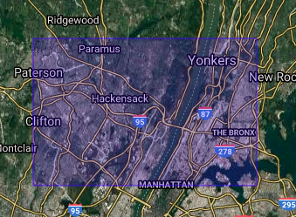
Challenges
Join Rooftop location and Solar Radiation location
Use Geohash to connect the tow tables
1mins/year
PV Rooftop
Radiation
Geometry | Zip Code
Latitude | Longitude
39.1km
40.87 -74.00
19.5km
Latitude | Longitude
40.8183 -73.9426
dr72
Geohash
Geohash
dr72

Slide 7
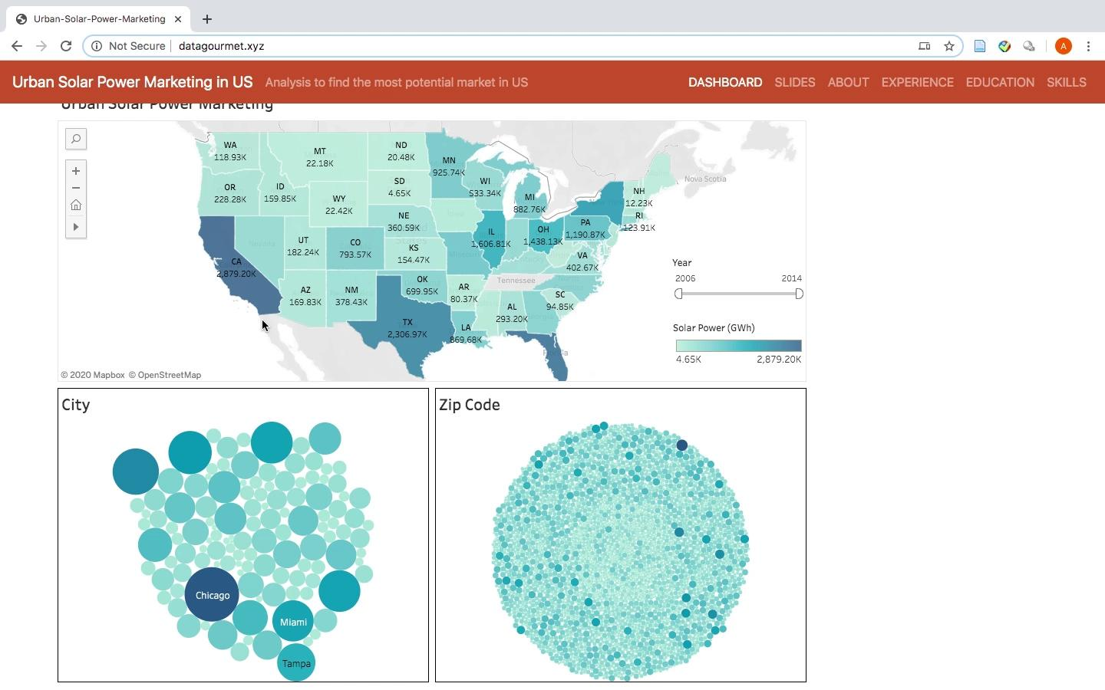
Front End
Tableau

Slide 8
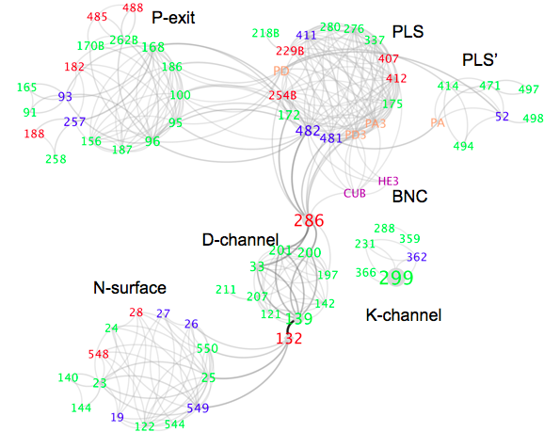




Xiuhong Cai
PhD in Physics
Molecular dynamics
Organized APS CUWiP @ NYC /CSSA leader
Zumba every week

Slide 9


Data
Rooftop information on buildings at 128 metropolitan areas
Solar radiation hourly/half-hourly data in US
PV Rooftop
100 GB
Solar Radiation
15 TB

Slide 10
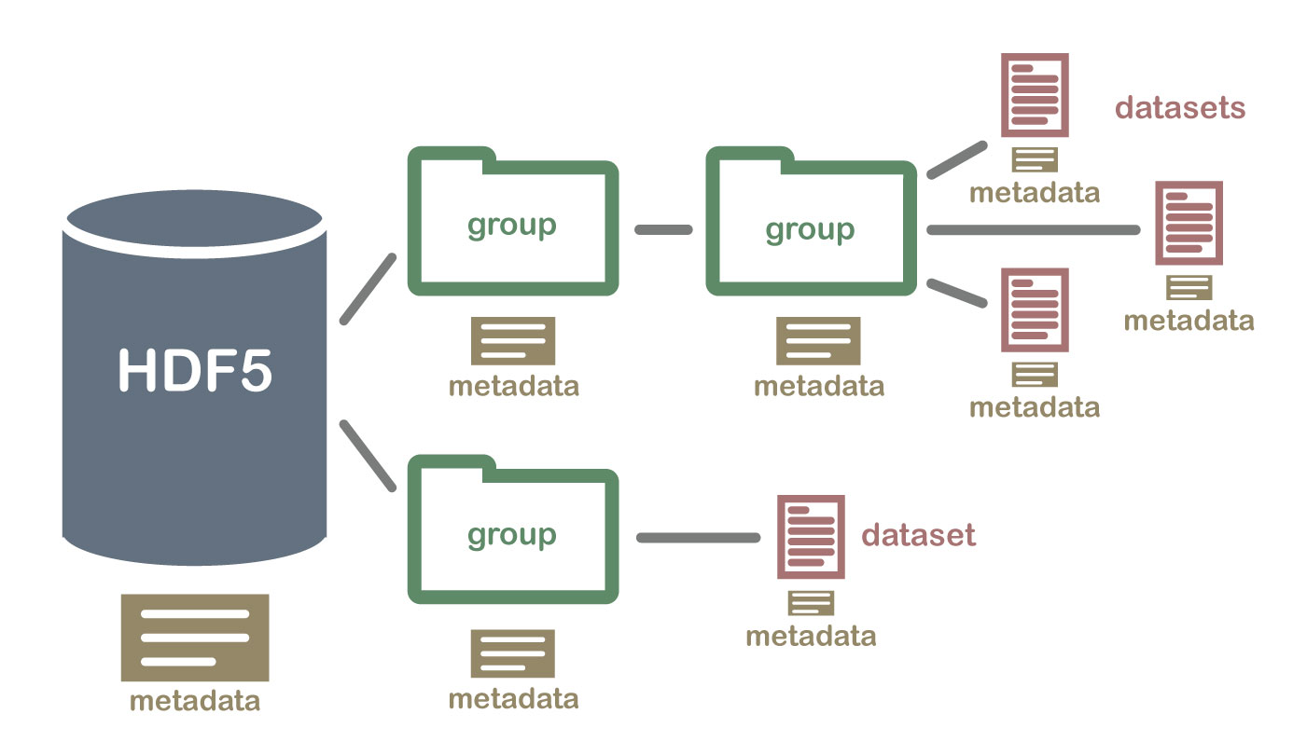
HDF File

Slide 11
Challenges
How to process a huge file (1.6TB/file) that can’t be loaded automatically to Spark from S3
Using S3fs/H5py, the data is reduced from 15TB to 100MB that can be loaded automatically to spark.
Method | Pros | Cons
Localhost/H5py | Fast: 222ms | Huge storage for EC2
HSDS, REST API/H5pyd | No storage, Fast: 103ms | Rate limit
S3fs/H5py | No storage, No Rate Limit | Slowest: 10.03s
Solution: read chunk by Spark -> S3

Slide 12
Geohash

Slide 13
Data Transform
building_id
footprint
flat_area
slop_area
zip
...
aspect
city
state
geom_4326
latitude
longitude
ghi
year
geohash
zip
city
state
tot_flat_area
tot_slop_area
tot_dev_area
ave_ghi
solar_power

Slide 14
Future Work
Model of solar power: transfer efficiency,
Electricity usage of residents

